Slide 1
Moisture, Humidity, and Temperature Control for a Garden Container
State University of New York at New Paltz
Jason Goodman, Karen Ho, Kevyn Martinez

Slide 2
Project Goal:
To implement a system that monitors the soil and ambient atmospheric conditions of a container that holds plants.
The system will keep the soil at a constant predetermined level.
The system will use a mobile friendly web app to monitor the container.

Slide 3
Software Used:
Python - Used for the main build
Initializr - Generated HTML5 template
Shell - Used for automation of command line arguments
Expect - Automates shell scripts
Adafruit DHT22 library - Interacts with the DHT22 sensor
JSON - Logs values after program execution
MySQL - Used for storing sensor data
PHP - Interacts with the database
New Paltz Wyvern Server

Slide 4
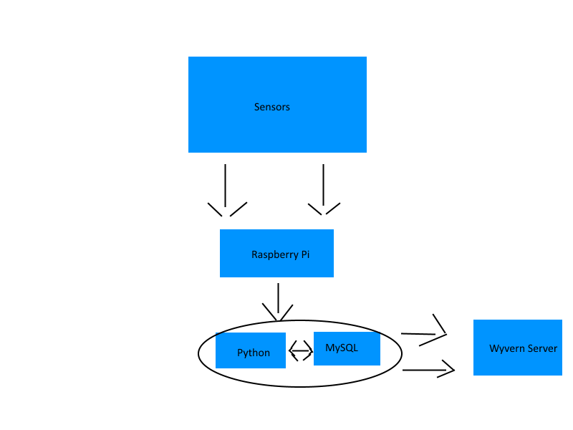
Design and Architecture

Slide 5
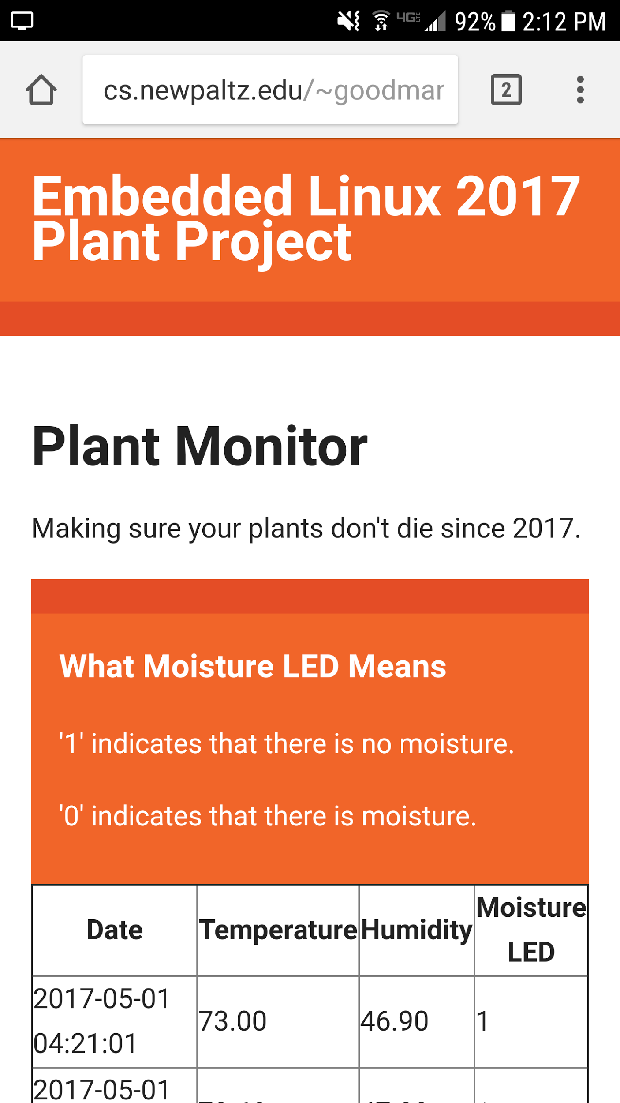
Website:
Initializr was used for the creation of the site.
Initializr allows you to generate HTML5 templates for whatever suits your needs.
Feel free to check out the site on your phones at-
cs.newpaltz.edu/~goodmanj3

Slide 6
End.

